Slide 1
Intelligent analytics
Notes:
Information in this document, including URL and other Internet Web site references, is subject to change without notice. Unless otherwise noted, the example companies, organizations, products, domain names, e-mail addresses, logos, people, places, and events depicted herein are fictitious, and no association with any real company, organization, product, domain name, e-mail address, logo, person, place or event is intended or should be inferred. Complying with all applicable copyright laws is the responsibility of the user. Without limiting the rights under copyright, no part of this document may be reproduced, stored in or introduced into a retrieval system, or transmitted in any form or by any means (electronic, mechanical, photocopying, recording, or otherwise), or for any purpose, without the express written permission of Microsoft Corporation.
Microsoft may have patents, patent applications, trademarks, copyrights, or other intellectual property rights covering subject matter in this document. Except as expressly provided in any written license agreement from Microsoft, the furnishing of this document does not give you any license to these patents, trademarks, copyrights, or other intellectual property.
The names of manufacturers, products, or URLs are provided for informational purposes only and Microsoft makes no representations and warranties, either expressed, implied, or statutory, regarding these manufacturers or the use of the products with any Microsoft technologies. The inclusion of a manufacturer or product does not imply endorsement of Microsoft of the manufacturer or product. Links may be provided to third party sites. Such sites are not under the control of Microsoft and Microsoft is not responsible for the contents of any linked site or any link contained in a linked site, or any changes or updates to such sites. Microsoft is not responsible for webcasting or any other form of transmission received from any linked site. Microsoft is providing these links to you only as a convenience, and the inclusion of any link does not imply endorsement of Microsoft of the site or the products contained therein.
© 2019 Microsoft Corporation. All rights reserved.
Microsoft and the trademarks listed at https://www.microsoft.com/en-us/legal/intellectualproperty/Trademarks/Usage/General.aspx are trademarks of the Microsoft group of companies. All other trademarks are property of their respective owners.

Slide 2
Abstract and learning objectives
In this whiteboard design session, you will work with a group to design a solution for building a real-time chat pipeline, incorporating machine learning and analytics to detect and visualize customer sentiment. You will also design a lambda architecture to handle both real-time chat processing and data archiving as well as search indexing for analyzing all data flowing through the system. Finally, you will determine whether a bot can be incorporated in the solution, and how it fits alongside the messaging capabilities.
At the end of this whiteboard design session, you will have a better understanding about how to design a real-time intelligent chat solution in Azure, which is scalable, enhanced by pre-built machine learning models, and the role bots can play as part of your overall solution.
Notes:
This is an introduction to the Cloud Workshop at a high level. Later we’ll get into customer objections, requirements, etc… but we want to ground the participants on the business outcomes we’re going after for the day.

Slide 3
Step 1: Review the customer case study
Outcome
Analyze your customer needs.
Timeframe
15 minutes

Slide 4

Customer situation - 2
First Up Consultants specialize in building software solutions for the hospitality industry.
Designing social chat app called Concierge+
Web app enables greater personalization and improve guest experience.
Notes:
First Up Consultants specialize in building software solutions for the hospitality industry.
They are designing their latest product as an enterprise grade, social chat app called Concierge+.
Support for one-on-one chat sessions between a hotel guest and a hotel concierge
Public chat room for hotel guests and hotel staff, called the Hotel Lobby
Full-text message search, including via #hashtags and @usernames
The mobile web app is intended to enable guests to easily stay in touch with the concierge and other guests, enabling greater personalization and improving their experience during their stay.

Slide 5


Customer situation - 3
Want a scalable and extensible solution
Allow hotel operators to track guest sentiment in real-time
Intelligently respond to and route guest request through the chat app
Automatically respond to guest questions
Log messages to a durable data store
Notes:
First Up Consultants wants to build a solution that is both scalable and extensible.
Scalable to support a thousand guests in a chat room (not that they expect this) or 2,000 concurrent on one-one chats.
Extensible in the sense that they can add new features on top of the solid, baseline real-time messaging functionality.
Hotel operators are motivated to keep tabs on guest sentiment in real-time, so they can respond to any upset guests quickly and turn a miserable stay into an amazing stay.
Wanting to be proactive-- experiment with automating the routing of routine guest requests (e.g., “Can I get more towels?”, “I forgot my toothbrush” and “Can I get a bottle of champagne”) that would otherwise require the attention of an already overloaded front desk attendant
A bot could answer a series of questions that guests are likely to ask.
They would like to log the messages to a durable store and make them full text searchable. To enable Twitter-like search for @entities and #labels.

Slide 6

Customer needs
Avoid using hardware they would have to maintain
Chat solution must be scalable and extensible
Automatically respond to guest questions with a bot
Fully searchable chat history
Real-time visualization of sentiment and trending sentiment over time
Notes:
First Up Consultants would like their Concierge+ service to avoid using any servers or VMs that they would have to maintain .
Their real-time chat solution needs to be scalable to support their largest hotel customers.
The chat solution needs to be extensible, provide support for sentiment analysis, and contextual understanding.
The solution should contain a bot capable of automatically responding to frequently asked customer questions. This will free up the time of their concierge desk staff to respond to more urgent matters.
The public chat history needs to be fully searchable.
The dashboard they use to visualize sentiment needs to update in real time as well as view trending sentiment over time.

Slide 7

Customer objections
Is Bot Framework the right solution?
Do not want to build machine learning models to detect customer sentiment.
Can a real-time, intelligent chat solution be built entirely in Azure?
Notes:
It is not clear if we should be using the Bot framework for our request forwarding or something else?
We do not want to build our own machine learning models in order to detect the sentiment of chat in real time.
Can we really build a real-time intelligent chat solution entirely in Azure?

Slide 8
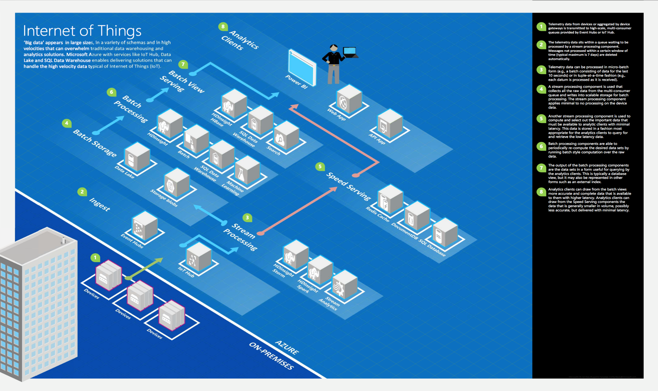
Common scenarios
Notes:
This is a diagram of a common architecture for this type of scenario, from which you can draw inspiration. You will find this diagram within the Whiteboard Design Session Student Guide.

Slide 9
Step 2: Design the solution
Outcome
Design a solution and prepare to present the solution to the target customer audience in a 15-minute chalk-talk format.
Timeframe
60 minutes
Business needs (10 minutes) | Respond to questions outlined in your guide and list the answers on a flipchart.
Design (35 minutes) | Design a solution for as many of the stated requirements as time allows. Show the solution on a flipchart.
Prepare (15 minutes) | Identify any customer needs that are not addressed with the proposed solution. Identify the benefits of your solution. Determine how you will respond to the customer’s objections. Prepare for a 15-minute presentation to the customer.
Notes:
It is time to design a solution.

Slide 10
Step 3: Present the solution
Outcome
Present a solution to the target customer in a 15-minute chalk-talk format.
Timeframe
30 minutes (15 minutes for each team to present and receive feedback)
Directions
Pair with another table.
One table is the Microsoft team and the other table is the customer.
The Microsoft team presents their proposed solution to the customer.
The customer asks one of the objections from the list of objections in the case study.
The Microsoft team responds to the objection.
The customer team gives feedback to the Microsoft team.

Slide 11
Wrap-up
Outcome
Identify the preferred solution for the case study.
Identify solutions designed by other teams.
Timeframe
15 minutes

Slide 12

Preferred target audience
Marc Tripp, CTO of First Up Consultants
Primary audience is business and technology decision makers.
Usually talk to Infrastructure Managers who report to the CIOs, or to application sponsors (like a VP LOB, CMO) or to those that represent the Business Unit IT or developers that report to application sponsors.
Notes:
Marc Tripp, the CTO of First Up Consultants
The primary audience is business decision makers and technology decision makers.
Usually we talk to the Infrastructure Managers who report into the CIOs, or to application sponsors (like a VP LOB, CMO) or to those that represent the Business Unit IT or developers that report into application sponsors.

Slide 13
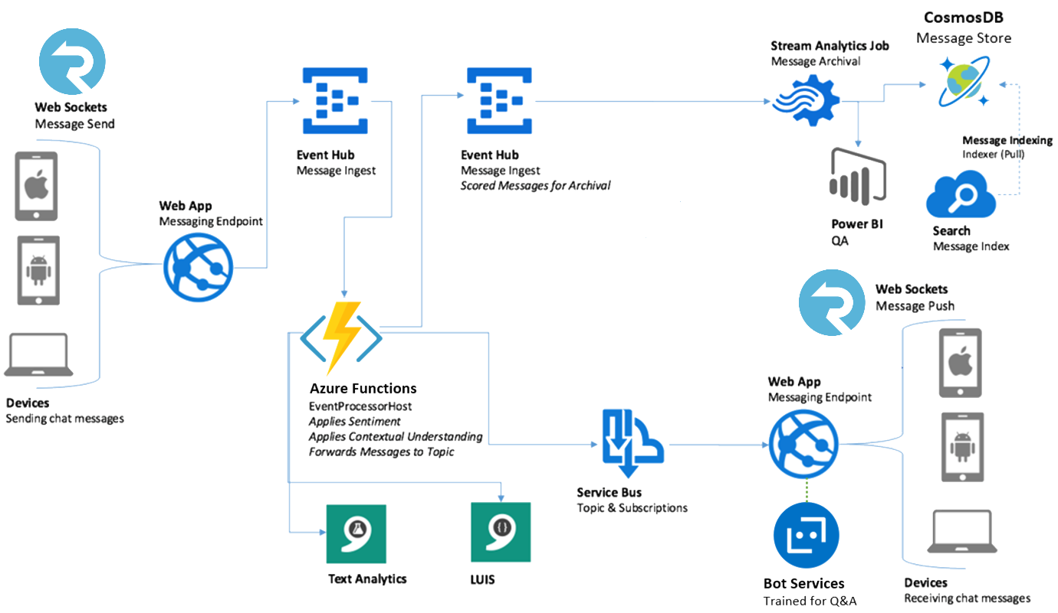
Preferred solution
Notes:
This preferred solution is just one of many viable options.
From a high level:
Messages are sent from browsers running within laptop or mobile clients via Web Sockets to a messaging endpoint running in an Azure Web App.
Chat messages received by the Web App are sent to an Event Hub where they are temporarily stored.
A Function App picks up the chat messages and applies sentiment analysis to the message text (using the Text Analytics API), as well as contextual understanding (using LUIS).
A Web Job forwards the chat message to an Event Hub used to store messages for archival purposes, and to a Service Bus Topic which is used to deliver the message to the intended recipients.
A Stream Analytics Job provides a simple mechanism for pulling the chat messages from the second Event Hub and writing them both to Cosmos DB for archiving, and to PowerBI for visualization of sentiment in real-time.
An indexer runs atop Cosmos DB that updates the Azure Search index which provides full text search capability.
Messages in the Service Bus Topic are pulled by Subscriptions created in the Web App and run on behalf of each client device connected by SignalR.
When the Subscription receives a message, it is pushed via SignalR down to the browser based app and displayed in a web page.

Slide 14
Preferred solution - 2
Baseline Chat
Use Web Sockets
Use Event Hubs
Azure Functions running Event Processor Host forward messages to Service Bus Topic for intermediate storage.
Chat sessions use Subscriptions and SessionIDs to identify message recipients.
Notes:
How would you recommend that First Up Consultants receive messages from mobile and desktop browsers?
Use Web Sockets for the device/browser to Web App, the Web App can forward on the messages to a messaging store.
How would you store ingested messages? Would you use Event Hubs or Service Bus?
Use Event Hubs.
By using Event Hub, the ingest of chat messages can scale to tremendous volumes, whilst also allowing new downstream consumer applications to be added as needed, without concern for Service Bus Topic and Subscription limits.
How would you forward messages to the intermediate storage from which the recipients will receive them? Would you use Stream Analytics or Web Jobs?
Azure Functions running Event Processor Host are used to pull chat messages from Event Hubs, and forward on to Service Bus Topic from which chat participants receive their messages.
Stream Analytics does not support message properties (it only works on the body) so Web Jobs would provide a more flexible solution in this case.
What queued storage would you use for the recipients and why?
Service Bus Topics would be used to store the messages while they await the recipient to retrieve them
Given your choice of intermediate storage, how would you implement a public chat room? How would you implement one-on-one chat?
A one-on-one chat consists of two Subscriptions (one for each user in the chat), each subscription with a SQL Filter where the filter examines the message property “SessionID”.
A public chat is many Subscriptions (one for each user in the chat) with a SQL Filter where the filter examines the message property “SessionID”.
The “connection” is made when messages are sent that have the same value for the SessionID property, because the message will be picked up by the Subscriptions that are listening for messages with that SessionID and ultimately delivered to the related client.

Slide 15
Preferred solution - 3
Sentiment Analysis
Use Text Analytics API to apply sentiment scores.
Sentiment processing handled with Azure Functions.
Notes:
What service would you recommend First Up Consultants capitalize on in order to scalably apply a sentiment score to each message as it enters the system?
The Text Analytics API, part of Microsoft Cognitive Services.
How would you enhance your baseline chat flow to incorporate this sentiment processing?
Azure Functions are used to pull chat messages from Event Hubs, invoke the Text Analytics API to apply sentiment scores to each message and to forward messages (now including a sentiment score) to Service Bus Topics from which chat participants receive their messages.

Slide 16
Preferred solution - 4
Request Forwarding
Implement LUIS API for understanding intent of customer messages.
Configure new LUIS app on the LUIS website.
Publish LUIS app as REST API.
Event Processor logic can forward messages to appropriate Service Bus Topic, based on intent.
Notes:
What Azure service or API would you suggest First Up Consultants utilize for understanding how to route guests requests to housekeeping or room service?
The Language Understanding Intelligent Service (LUIS) API, which is a part of Microsoft Cognitive Services would enable First Up Consultants to define contextual models that can identify intents (e.g., what the chat user is wanting to do) and entities (e.g., the subject of their action).
How would you implement or configure this service?
Provision a Cognitive Services account with the API type of LUIS using the Azure Portal.
Use the website at https://www.luis.ai/ to create a new app.
Update the App Settings with the key they acquired from the Azure Portal.
Use the LUIS website to define their intents (e.g., one for ordering room service for the delivery of food, and another intent for the requesting the delivery of room items ) and entities (food items like pizza, pasta or wine and room items like toothpaste or pillows)
Improve LUIS’s model by providing utterances (examples)
Publish as REST API
How would you integrate this service into your chat message processing flow?
Event Processor logic should be extended to support the processing of requests
if the message matches one of the configured intents or no intent.
If it matches an intent, then Event Processor logic could forward the message on to the Service Bus Topic appropriate for room service or housekeeping, from which they could then respond to the guest as appropriate.
If it does not match an intent, the message would be forwarded on to the intended Topic with the expectation that hotel staff would respond to it.

Slide 17
Preferred solution - 5
Q&A Bot
Use Cognitive Services QnA Maker to create a knowledge base.
Create an instance of Bot Services that connects to QnA Maker knowledge base.
Embed the bot into the web app.

Slide 18
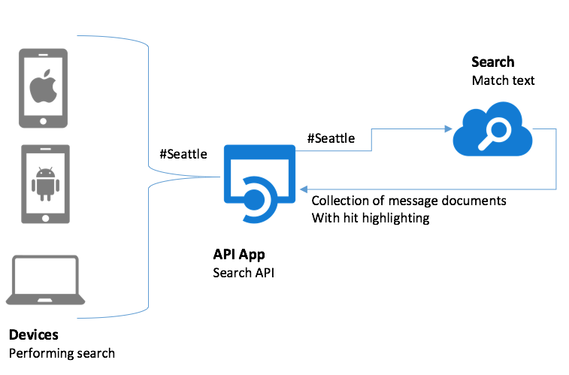
Preferred solution - 6
Message Search
Chat message flows through Event Hubs
Message stored in Cosmos DB
Full-text search through Azure Search
Notes:
What Azure services would you use to durably store the messages and enable them for full text search? How would you extend your messaging pipeline so that all messages get archived after they have been tagged with sentiment?
All chat messages flow thru Event Hubs and are stored in Cosmos DB. To support searching of messages, an Azure Search Index is created that is updated every five minutes by an Azure Search Indexer that pulls new message entries from Cosmos DB.
Once a message is indexed within Azure Search, its properties (such as the username of the user who sent it) and its message text become full-text searchable.
To perform a search, the browser which loads the search web page on the device makes a cross-origin, XmlHttpRequest to an API App that wraps requests to the Azure Search API
The messages matching the search are returned, with HTML and CSS formatting embedded so that the particular text that matches the search query is emphasized upon results display.

Slide 19

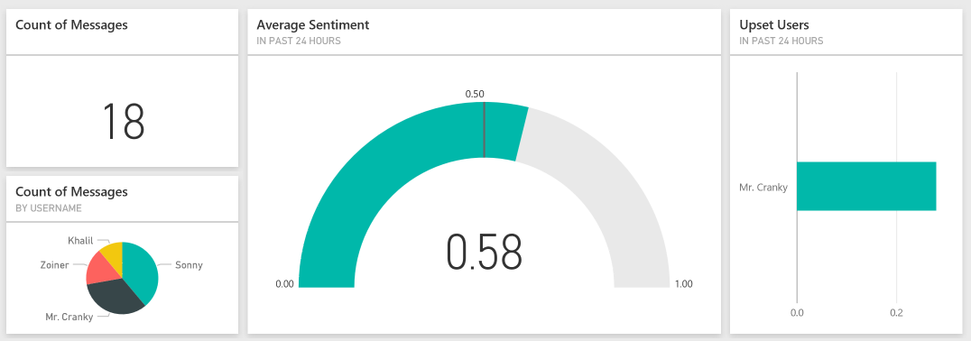
Preferred solution - 7
Visualization and Reporting
Use Power BI
Create dashboard with Power BI QA
Notes:
What tool would you recommend First Up Consultants utilize for constructing their real-time sentiment dashboard?
Use Power BI. Note that they would have to use PowerBI.com to build these dashboards, as currently real-time dashboards cannot be built using Power BI Desktop.
How would you build this dashboard using the tool you recommended?
To build a real-time dashboard in PowerBI, one needs to create a dashboard populated with visuals created using PowerBI QA on data coming into the dataset from the Stream Analytics Job
In the “Ask a question about your data”, they would enter a question that would drive the visualization, such as: “average score created between yesterday and today”. Then adjust the visuals and point to a dashboard.

Slide 20
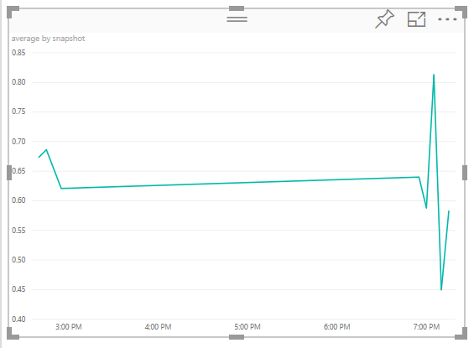
Preferred solution - 8
Visualization and Reporting
Stream Analytics sends a second dynamic dataset to Power BI, averaging sentiment within a tumbling window in 5-minute increments.
This trending sentiment is displayed within the dashboard as well.

Slide 21
Preferred objections handling
Is Bot Framework the right solution?
Do not want to build machine learning models to detect customer sentiment.
Can a real-time, intelligent chat solution be built entirely in Azure?
Notes:
It is not clear if we should be using the Bot framework for our request forwarding or something else?
The Bot Framework is intended for building chat bots that integrate with existing services such as text/sms, Skype, Slack and Office 365 —on its own it does not provide a chat messaging framework.
In First Up Consultants’ case, they are looking for an in-house chat solution, so the Bot framework would not be an appropriate solution.
Bot Framework is appropriate for the Q&A bot capabilities they have asked for, so it’s used in conjunction with the in-house chat solution.
We do not want to build our own machine learning models in order to detect the sentiment of chat in real time.
By using the Text Analytics API, First Up Consultants is able to leverage a field tested, performant text sentiment model that requires only invocation by web service call.
Can we really build a real-time, intelligent chat solution entirely in Azure?
Yes!

Slide 22
Customer quote
“What’s cooler than sentiment analysis on real-time chat? Azure, because it enables us to give hotel operators back the connection they lost as their hotel sizes increased”
- Marc Tripp, CTO of First Up Consultants

